Slide 1

Infosys Springboard
Internship
ELECTRICITY DEMAND AND PRICE FORECASTING
Submitted BY:- Challa Anjani Kumar Reddy
Email:- anjanikumarchalla694@gmail.com
JULY 2024

Slide 2

INFOSYS SPRINGBOARD
Introduction:
Objective: Forecasting electricity demand and prices using machine learning models.
Importance: Accurate forecasting helps in efficient energy management and cost savings.
Problem:
Challenges: Variability in electricity demand and price due to multiple factors like weather, time of day, and seasonality.
Goal: Develop a robust model to predict electricity demand and prices.

Slide 3

INFOSYS SPRINGBOARD
INDEX:
Introduction
Problem Statement
Granularity
Data Preprocessing
Feature Engineering
Exploratory Data Analysis (EDA)
Feature Selection
Model Building
Model Selection and Evaluation
Conclusion

Slide 4
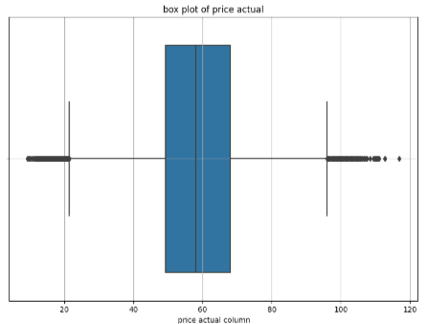
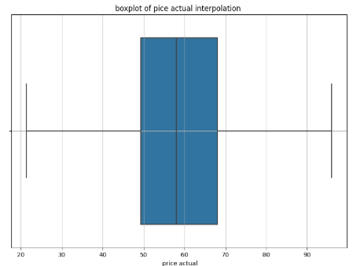
INFOSYS SPRINGBOARD
Granularity:
Data Level: The project utilizes hourly data for electricity demand and prices, ensuring fine-grained insights into short-term fluctuations.
Detail in Features: Includes weather conditions, time-based features , and seasonal indicators to capture comprehensive factors affecting demand and price.
Level of Detail: Hourly data for demand and prices, along with weather conditions.
Preprocessing:
Steps:
Aggregating weather data.
Merging datasets.
Filling empty rows with forward fill and backward fill technique
Identifying and handling outliers in price data using interpolation.
Outcome:
Cleaned and merged dataset ready for analysis.
Before removing outliers in price column
After removing outliers in price column

Slide 5
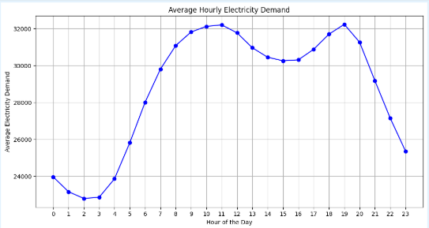
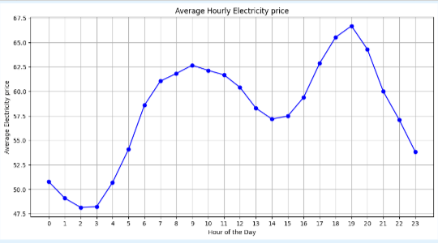
INFOSYS SPRINGBOARD
Feature Engineering:
New Features:
is_weekday: Identifies weekdays.
peak_off_peak: Differentiates between peak and off-peak hours for load and price.
Seasonal columns: Indicating the season of the data.
is_weekend: Identifies weekends.
Encoding:
One-hot encoding for day of the week and month.
Label encoding for weather-related columns to reduce the number of columns.
Exploratory Data Analysis (EDA)
Data Visualization:
Hourly Average Demand and Price: Graphs showing patterns over 24 hours.

Slide 6
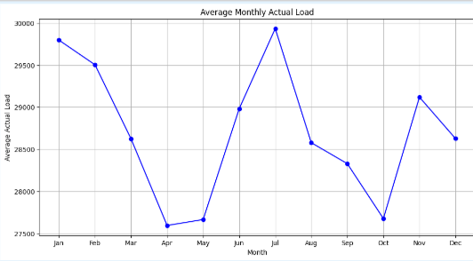

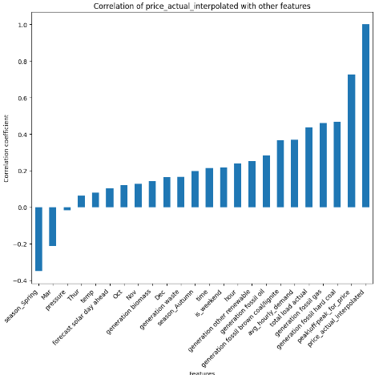
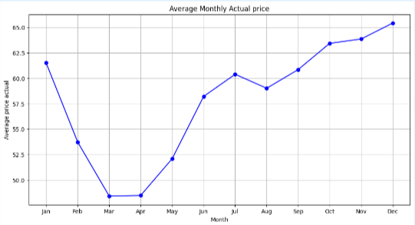
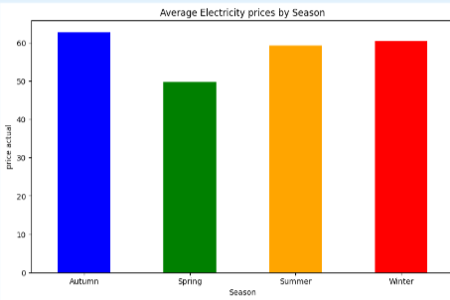
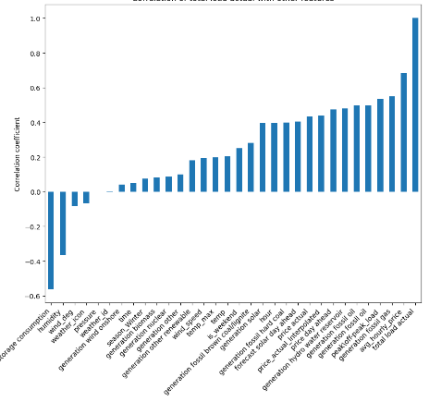
INFOSYS SPRINGBOARD
Data Visualization:
Monthly Average Load and Price
seasonly Average Load and Price
Correlation Graph for Load and Price
Load Actual
Load Actual
Load Actual
Price Actual
Price Actual
Price Actual

Slide 7

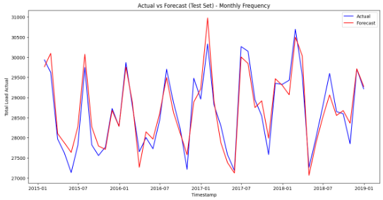
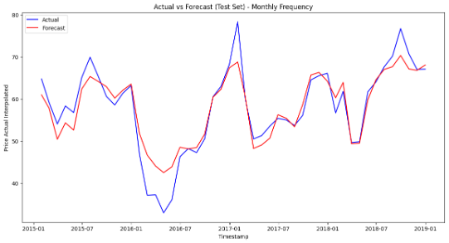
INFOSYS SPRINGBOARD
Feature Selection:
Objective: Identify independent variables that help in predicting target variables.
Techniques Used:
Correlation Analysis: Identified features with correlation above 0.1.
Domain Knowledge: Included relevant features like weather conditions and time-based features.
Feature Importance from Models: Used techniques like feature importance scores from Random Forest to identify key predictors.
Model Building:
Linear Regression:
Load Prediction - Test Set MAE: 895.823 RMSE: 1147.9 MAPE: 3.2 R²: 0.93 Adjusted R²: 0.93
Price Prediction - Test Set MAE: 5.443 RMSE: 6.98 MAPE: 10.98 R²: 0.74 Adjusted R²: 0.74
Load Actual
Price Actual

Slide 8
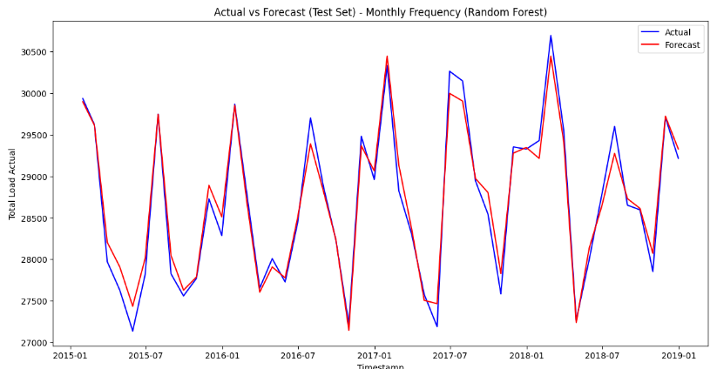
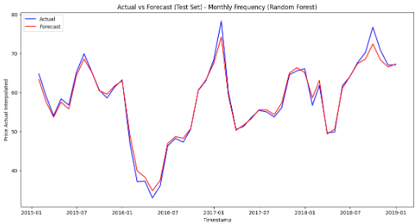
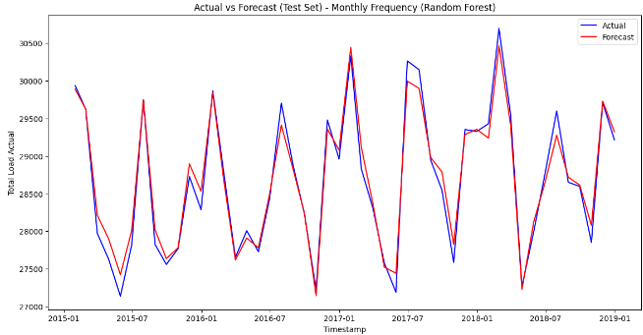

INFOSYS SPRINGBOARD
Random Forest
Load Prediction - Test Set MAE: 704.16 RMSE: 937.27 MAPE: 2.5 R²: 0.95 Adjusted R²: 0.95
Price Prediction - Test Set MAE: 3.05 RMSE: 4.16 MAPE: 5.8 R²: 0.90 Adjusted R²: 0.90
Load Actual
Price Actual
Random Forest(with tuning)
Load Prediction with 1000 Trees - Test Set MAE: 696.88 RMSE: 926.87 MAPE: 2.49 R²: 0.958 Adjusted R²: 0.958
Price Prediction with 170 Trees- Test Set MAE: 2.97 RMSE: 4.00 MAPE: 5.76 R²: 0.916 Adjusted R²: 0.915
Load Actual
Price Actual

Slide 9
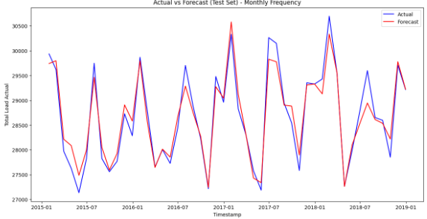
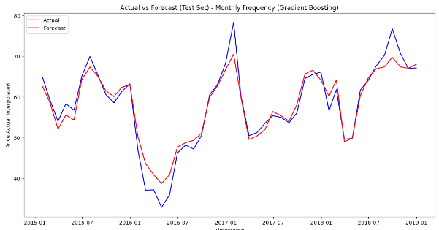
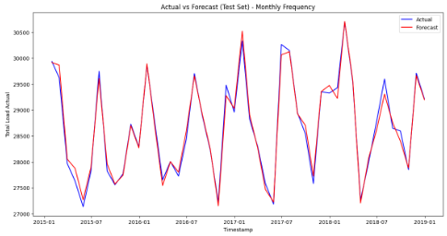
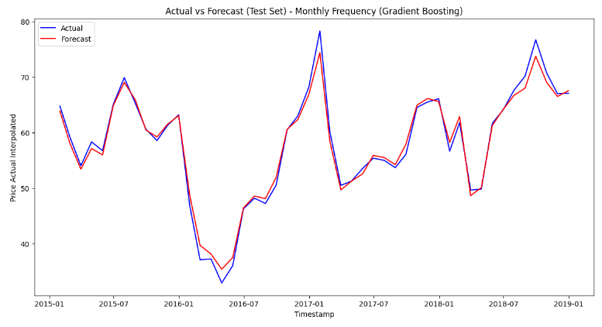
INFOSYS SPRINGBOARD
Gradient descent
Load Prediction - Test Set
(Gradient Boosting) MAE: 917.79 RMSE: 1163.08 MAPE: 3.2 R²: 0.93 Adjusted R²: 0.93
Price Prediction - Test Set (Gradient Boosting) MAE: 4.58 RMSE: 5.87 MAPE: 8.9 R²: 0.81 Adjusted R²: 0.81
Load Actual
Price Actual
Gradient descent(with tuning)
Best Parameters: {'learning_rate': 0.3, 'n_estimators': 300}
Load Prediction - Test Set MAE: 637.23 RMSE: 824.29 MAPE: 2.2 R²: 0.967 Adjusted R²: 0.967
Best Parameters:
{'learning_rate': 0.3,
'n_estimators': 1000}
Price Prediction - Test Set MAE: 3.47 RMSE: 4.53 MAPE: 6.6 R²: 0.89 Adjusted R²: 0.89
Load Actual
Price Actual

Slide 10
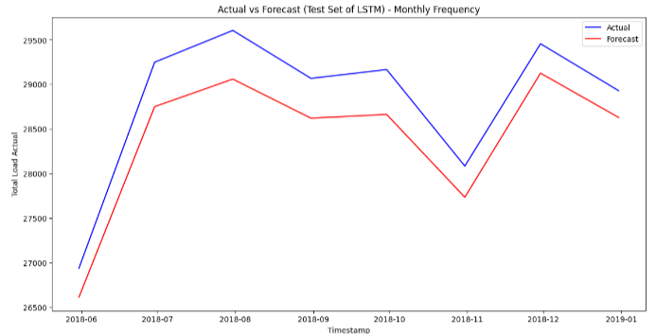
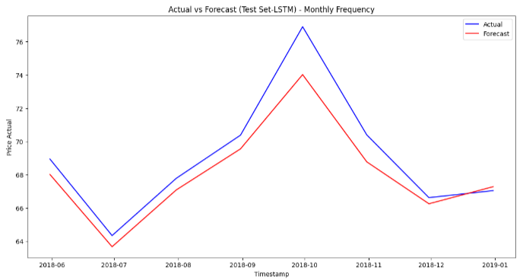
INFOSYS SPRINGBOARD
Long short-term memory
Load Prediction - Test Set
MAPE: 2.76 MAE: 1.92 RMSE: 2.47
R²: 0.90 Adjusted R²: 0.90
Price Prediction - Test Set
MAPE: 2.1 MAE: 633.48 RMSE: 811.84
R²: 0.968 Adjusted R²: 0.968
Load Actual
Price Actual
The above graphs of actual vs forecast are only for test data.

Slide 11
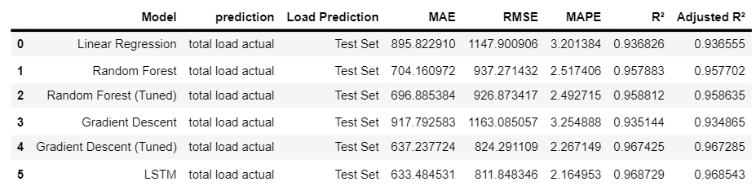
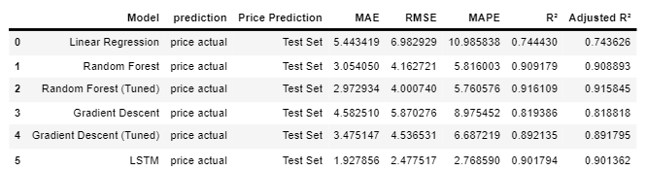
INFOSYS SPRINGBOARD
Model Selection:
Criteria:
Performance metrics (e.g., RMSE, MAE, R^2, Adjusted R^2).
Comparison of different models on training and validation sets.
Outcome: Selection of LSTM as the best-performing model based on evaluation metrics.

Slide 12
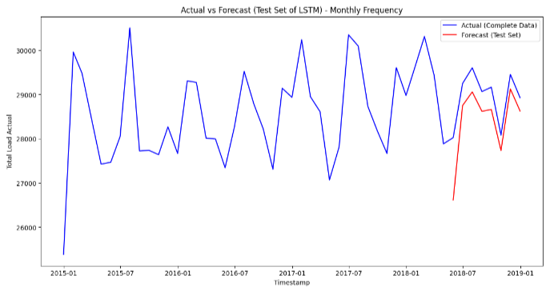
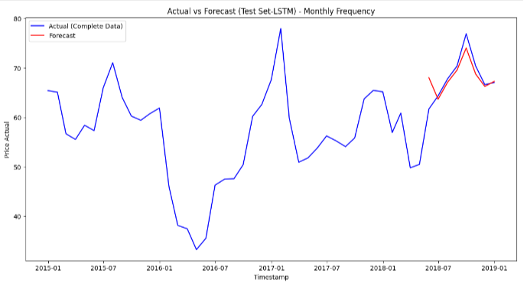
Final output of lstm model
INFOSYS SPRINGBOARD
Load Actual
Load Actual
Price Actual
Price Actual
The above actual vs forecast graphs contain actual line for complete data but forecast line is only for test data.

Slide 13
Conclusion:
INFOSYS SPRINGBOARD
Model Performance:
Among the various models tested, the LSTM model outperformed others in accurately forecasting both electricity demand and prices.
The use of advanced feature selection techniques, such as correlation analysis and feature importance from models, ensured the selection of relevant predictors, improving model accuracy.
LSTM Model Output for Total Load Actual:
R²: 0.9687: Explains 96.87% of the variance in total load.
Adjusted R²: 0.9685: Slightly adjusted for the number of predictors, still very high.
MAPE: 2.16: Very low percentage error, indicating high accuracy.
MAE: 633.48: Average absolute error in load predictions.
RMSE: 811.85: Indicates the magnitude of prediction errors.
LSTM Model Output for Actual Price:
R²: 0.9018: Explains 90.18% of the variance in actual prices.
Adjusted R²: 0.9014: Slightly adjusted for the number of predictors, still very high.
MAPE: 0.0277: Very low percentage error, indicating high accuracy.
MAE: 1.93: Average absolute error in price predictions.
RMSE: 2.48: Indicates the magnitude of prediction errors.
Implications:
Accurate forecasting models can significantly enhance energy management and planning, leading to cost savings and more efficient resource allocation.
The approach demonstrated can be adapted and extended to other time series forecasting problems, showcasing the versatility of machine learning models in predictive analytics.

Slide 14
THANK
YOU

